Slide 1
DRIVER FATIGUE DETECTION SYSTEM
Batch: D9
Team members:
Alluri Kavya Sri Saini (16241A05I5)
Gali Anusha (16241A05J4) Project Guide
Sohila Manthena (16241A05K7) G. Devi Priya
Manvitha Patibandla (16241A05K8) (Assistant Professor)

Slide 2
ABSTRACT
In recent years driver fatigue is one of the major causes of vehicle accidents in the world. A direct way of measuring driver fatigue is measuring the state of the driver i.e. drowsiness. This project is aimed towards developing a prototype of drowsiness detection system.
This system is a real time system which captures image continuously and measures the state of the eye according to the specified algorithm and gives warning if required.
Though there are several methods for measuring the drowsiness but this approach is completely non-intrusive which does not affect the driver in any way, hence giving the exact condition of the driver.
For detection of drowsiness the per closure value of eye is considered. So when the closure of eye exceeds a certain amount then the driver is identified to be sleepy. For implementing this system several OpenCv libraries are used including Haar-cascade.

Slide 3
EXISTING SYSTEM
Feature-based eye detection:
Image binarization and projection assuming that eye is darker than the skin.
Color-based face recognition:
Face is detected based on the color of skin and shape of the face.
Drowsiness Detection using Raspberry Pi:
Raspberry Pi is used for processing the algorithm.

Slide 4
DRAWBACKS
Color-based face recognition: In noisy images or in images with low illuminations, these algorithms have low accuracy.
Feature-based eye detection has higher error rate and complicated processing.
Drowsiness Detection using Raspberry Pi:
Raspberry Pi doesn’t perform fast video processing as the processing speed is only 700 Mhz.
It can’t keep up with the demands of some modern software.
It has limited amount of memory.

Slide 5
PROPOSED SYSTEM
We use Haar feature based cascade classifiers and facial landmark(present in dlib library) to localize the face and detect the regions such as eyebrows, eye , mouth and nose
Our approach is focused on the state of eye in each frame being captured and an eye aspect ratio is calculated and a decision is made whether the eyes are open or closed.
It is also non-intrusive in nature, hence does not affect the state of the driver and also the driver feels totally comfortable with this system.
Environmental factors like road condition do not affect this system. The case of micro nap is also detected according the given threshold value.

Slide 6
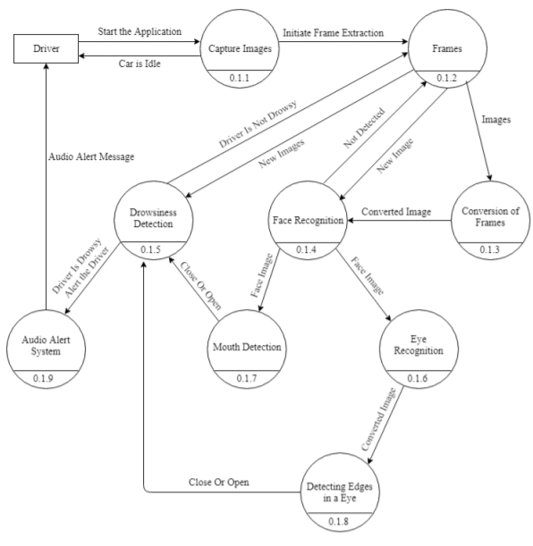
SOFTWARE ARCHITECTURE /DATA FLOW DIAGRAM

Slide 7
MODULES
Face detection
Eye detection
Recognition of Eye’s state
Eye state determination
Fatigue detection

Slide 8
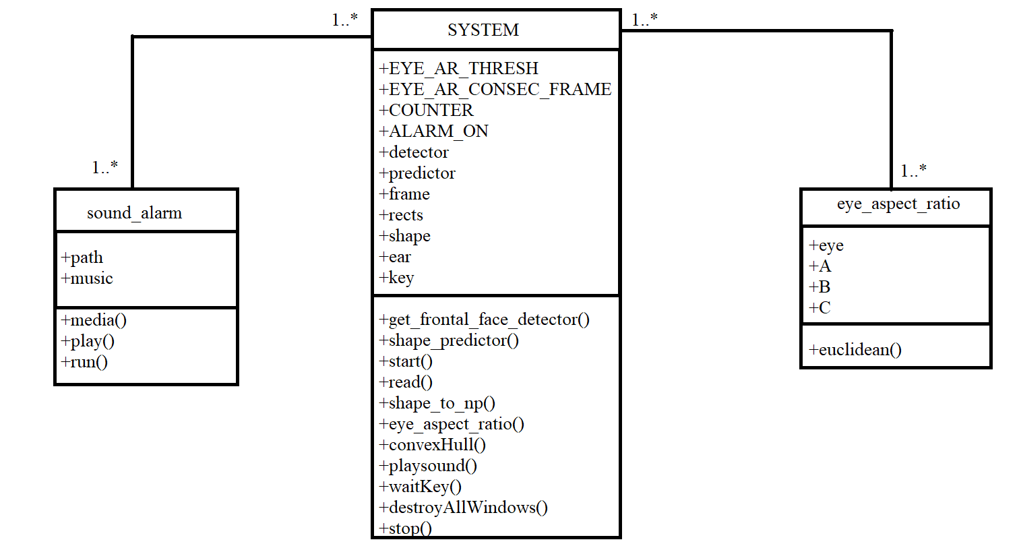
CLASS DIAGRAM

Slide 9
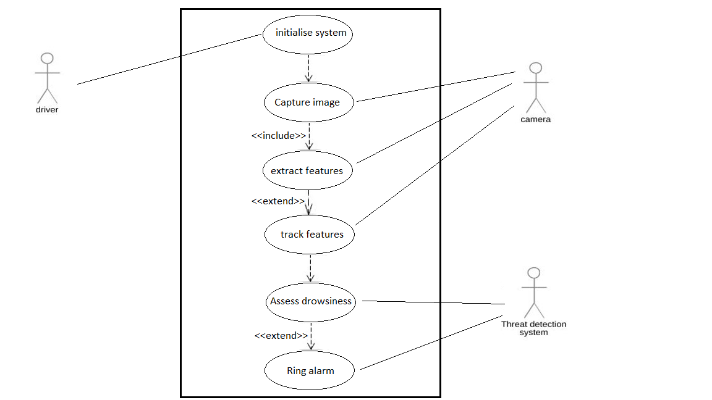
USE CASE DIAGRAM

Slide 10
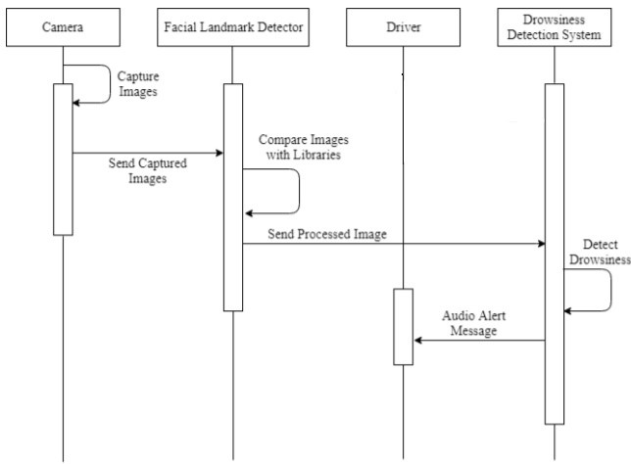
SEQUENCE DIAGRAM

Slide 11
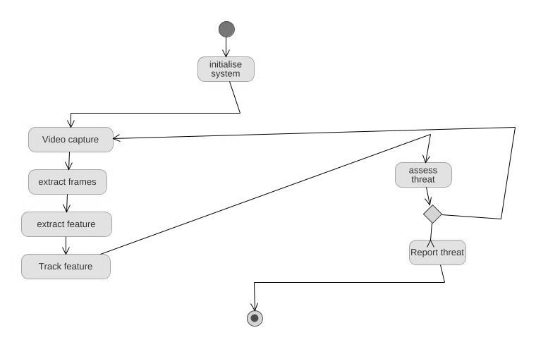
ACTIVITY DIAGRAM

Slide 12
CODE
from scipy.spatial import distance as dist
from imutils.video import VideoStream
from imutils import face_utils
from threading import Thread
import numpy as np
import pyglet
import argparse
import imutils
import time
import dlib
import cv2
from playsound import playsound
def sound_alarm(path):
music = pyglet.resource.media('alarm.wav')
music.play()
pyglet.app.run()

Slide 13
CODE
def eye_aspect_ratio(eye):
A = dist.euclidean(eye[1], eye[5])
B = dist.euclidean(eye[2], eye[4])
C = dist.euclidean(eye[0], eye[3])
ear = (A + B) / (2.0 * C)
return ear
ap = argparse.ArgumentParser()
ap.add_argument("-w", "--webcam", type=int, default=0,
help="index of webcam on system")
args = vars(ap.parse_args())
EYE_AR_THRESH = 0.3
EYE_AR_CONSEC_FRAMES = 48
COUNTER = 0
ALARM_ON = False

Slide 14
CODE
print("[INFO] loading facial landmark predictor...")
detector = dlib.get_frontal_face_detector()
predictor = dlib.shape_predictor("68 face landmarks.dat")
(lStart, lEnd) = face_utils.FACIAL_LANDMARKS_IDXS["left_eye"]
(rStart, rEnd) = face_utils.FACIAL_LANDMARKS_IDXS["right_eye"]
print("[INFO] starting video stream thread...")
vs = VideoStream(src=args["webcam"]).start()
time.sleep(1.0)
while True:
frame = vs.read()
frame = imutils.resize(frame, width=450)
gray = cv2.cvtColor(frame, cv2.COLOR_BGR2GRAY)
rects = detector(gray, 0)

Slide 15
CODE
for rect in rects:
shape = predictor(gray, rect)
shape = face_utils.shape_to_np(shape)
leftEye = shape[lStart:lEnd]
rightEye = shape[rStart:rEnd]
leftEAR = eye_aspect_ratio(leftEye)
rightEAR = eye_aspect_ratio(rightEye)
ear = (leftEAR + rightEAR) / 2.0
leftEyeHull = cv2.convexHull(leftEye)
rightEyeHull = cv2.convexHull(rightEye)
cv2.drawContours(frame, [leftEyeHull], -1, (0, 255, 0), 1)
cv2.drawContours(frame, [rightEyeHull], -1, (0, 255, 0), 1)
if ear < EYE_AR_THRESH:
COUNTER += 1

Slide 16
CODE
if COUNTER >= EYE_AR_CONSEC_FRAMES:
if not ALARM_ON:
ALARM_ON = True
cv2.putText(frame, "DROWSINESS ALERT!", (10, 30),
cv2.FONT_HERSHEY_SIMPLEX, 0.7, (0, 0, 255), 2)
playsound('alarm.wav')
else:
COUNTER = 0
ALARM_ON = False
cv2.putText(frame, "EYE: {:.2f}".format(ear), (300, 30),
cv2.FONT_HERSHEY_SIMPLEX, 0.7, (0, 0, 255), 2)
cv2.imshow("Frame", frame)
key = cv2.waitKey(1) & 0xFF
if key == ord("q"):
break
cv2.destroyAllWindows()
vs.stop()

Slide 17
REQUIREMENTS
HARDWARE
SOFTWARE
Memory: 8GB RAM
Hard Disk: 64GB or more
Processor: Intel Pentium 4 processor
Input devices: Webcam
Output devices: Audio
Python 3.0 or higher

Slide 18
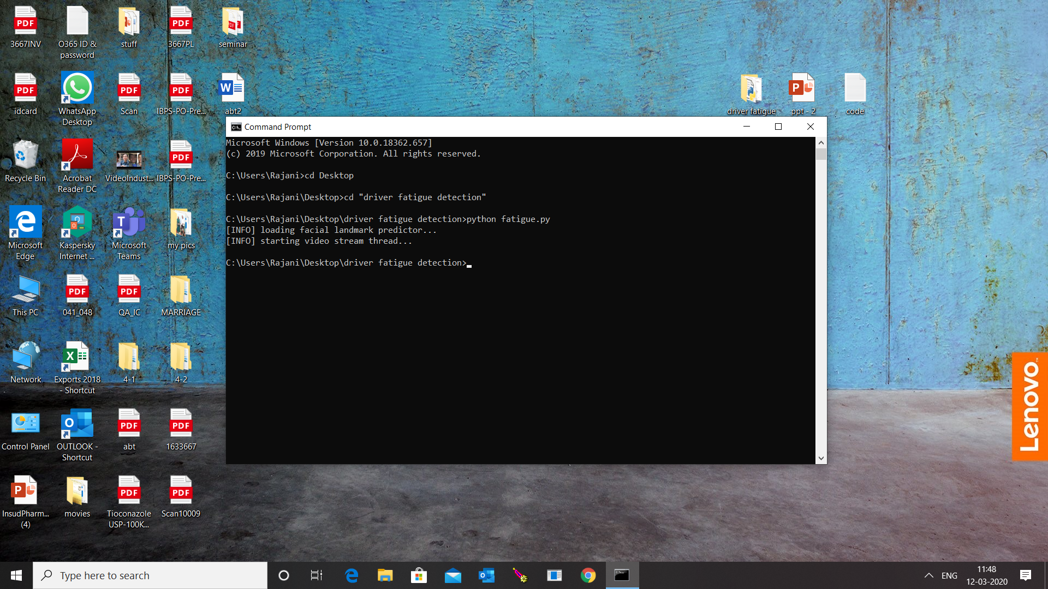
OUTPUT

Slide 19
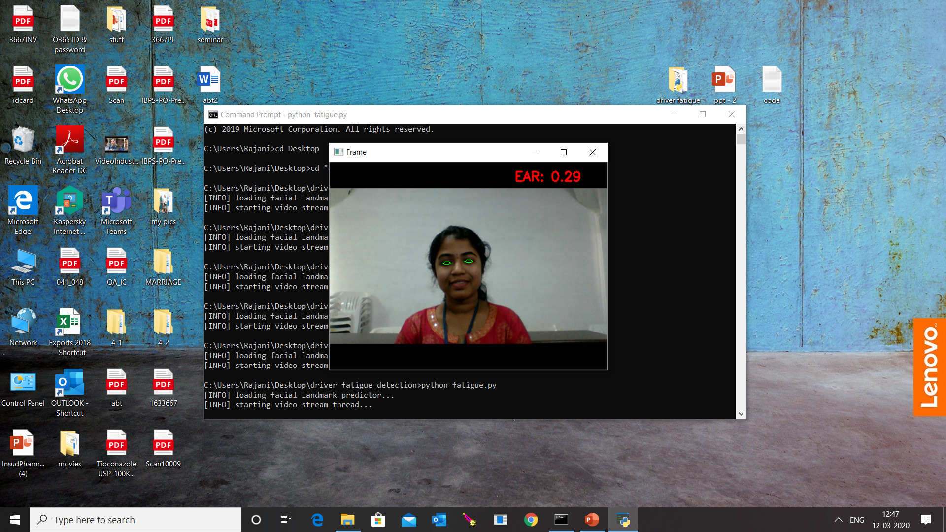
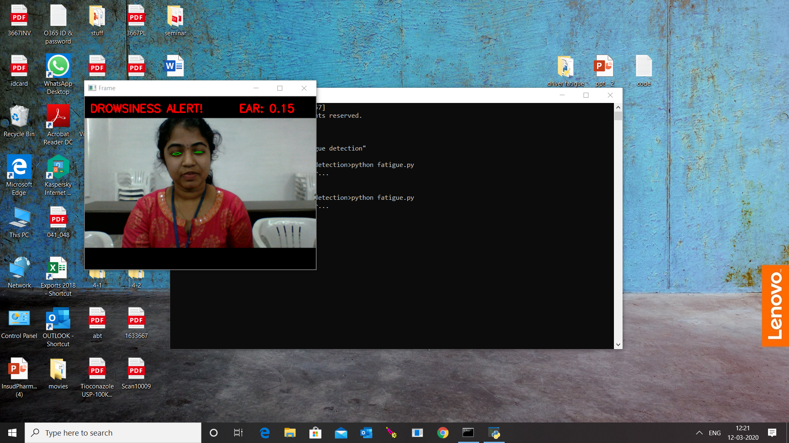
OUTPUT

Slide 20
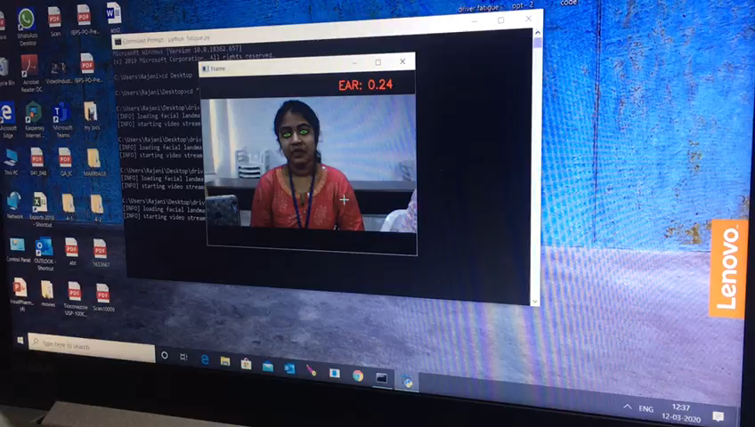
OUTPUT

Slide 21
THANK YOU

